Slide 1

Face recognition
What is face recognition?
deeplearning.ai

Slide 2
Face recognition
A face recognition demo made by Yuanqing Li when Andrew worked in Baidu.
[Courtesy of Baidu]

Slide 3
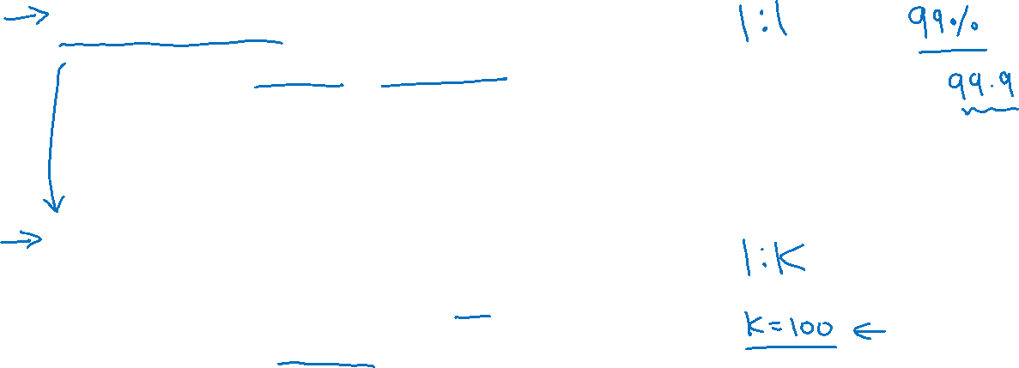
Face verification vs. face recognition
Verification
Input image, name/ID
Output whether the input image is that of the claimed person
Recognition
Has a database of K persons
Get an input image
Output ID if the image is any of the K persons (or “not recognized”)

Slide 4
Face recognition
One-shot learning
deeplearning.ai

Slide 5

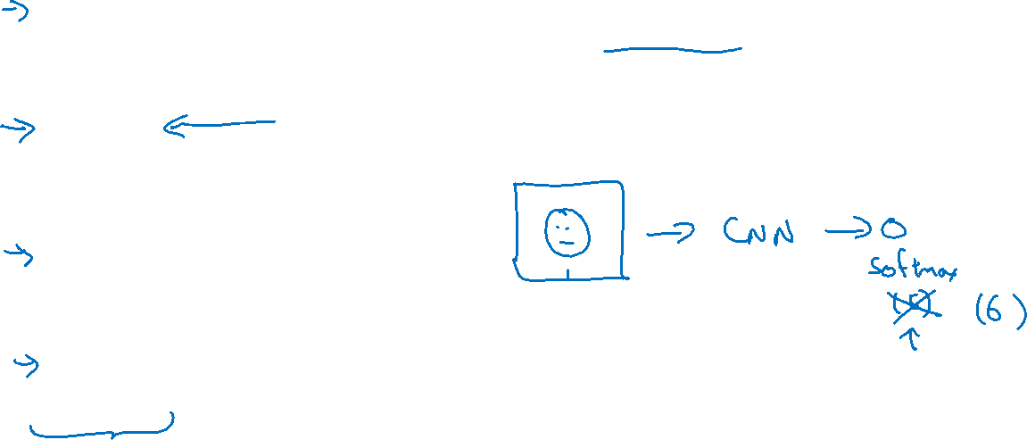
One-shot learning
Learning from one example to recognize the person again

Slide 6

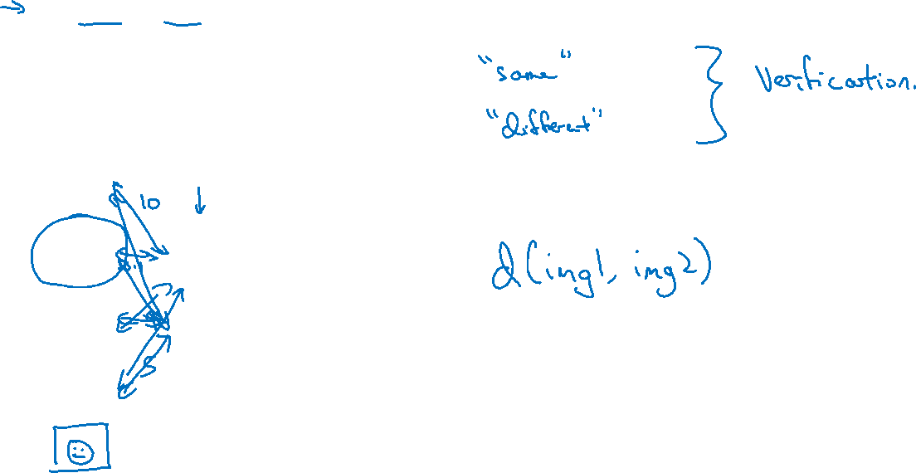
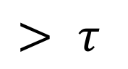
Learning a “similarity” function
d(img1,img2) $=$ degree of difference between images
If d(img1,img2) $≤ τ$
$$> τ$$

Slide 7
Face recognition
Siamese network
deeplearning.ai

Slide 8
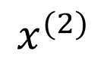

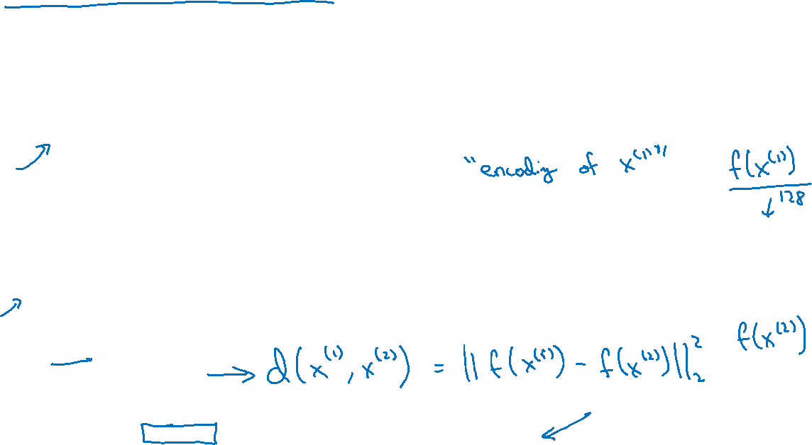
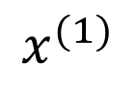
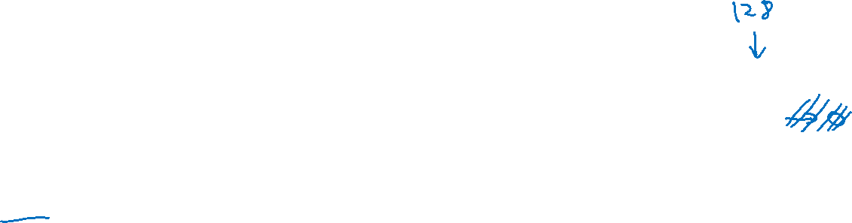
Siamese network
$$⋮$$
$$⋮$$
$$x^{(1)}$$
$$⋮$$
$$⋮$$
$$x^{(2)}$$
[Taigman et. al., 2014. DeepFace closing the gap to human level performance]

Slide 9
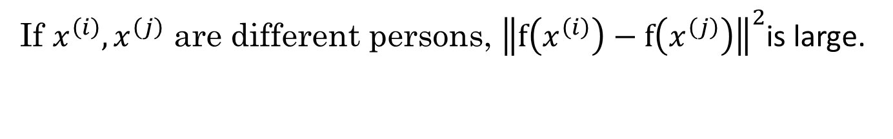
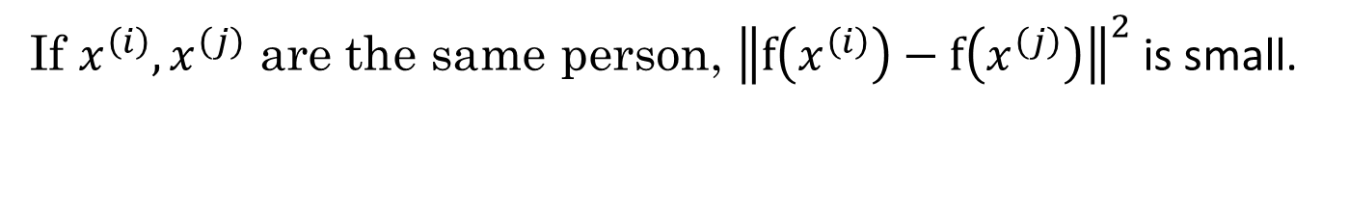
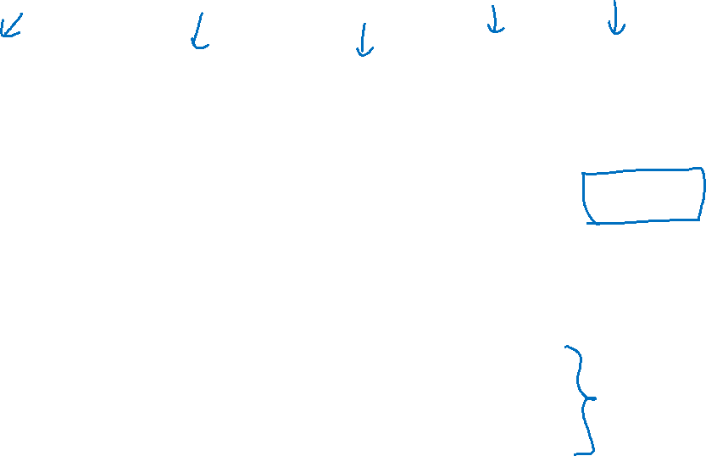
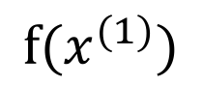

Goal of learning
$$⋮$$
$$⋮$$
$$f(x^{(1)})$$
Parameters of NN define an encoding $f(x^{\left(i\right)})$
Learn parameters so that:
If $x^{\left(i\right)},x^{\left(j\right)}$ are the same person, ${\left\|f\left(x^{\left(i\right)}\right)−f\left(x^{\left(j\right)}\right)\right\|}^{2}$ is small.
If $x^{\left(i\right)},x^{\left(j\right)}$ are different persons, ${\left\|f\left(x^{\left(i\right)}\right)−f\left(x^{\left(j\right)}\right)\right\|}^{2}$is large.

Slide 10
Face recognition
Triplet loss
deeplearning.ai

Slide 11
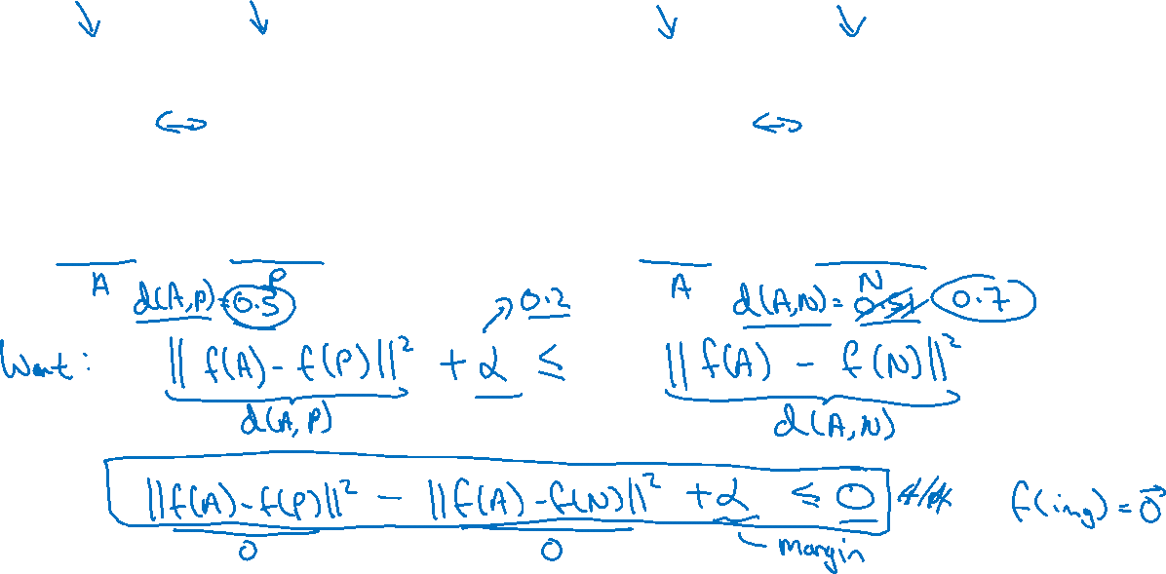
Learning Objective
Anchor
Positive
Anchor
Negative
[Schroff et al.,2015, FaceNet: A unified embedding for face recognition and clustering]

Slide 12
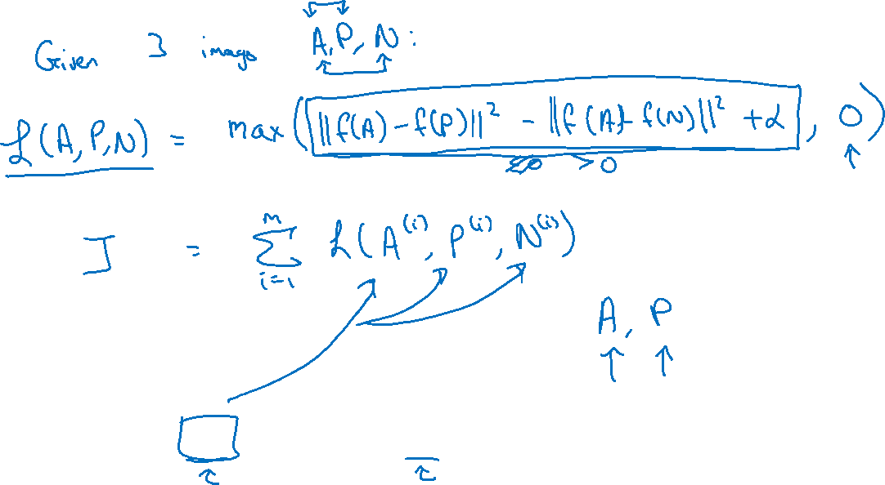
Loss function
Training set: 10k pictures of 1k persons
[Schroff et al.,2015, FaceNet: A unified embedding for face recognition and clustering]

Slide 13
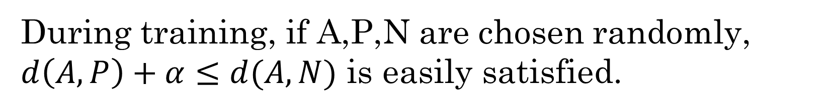
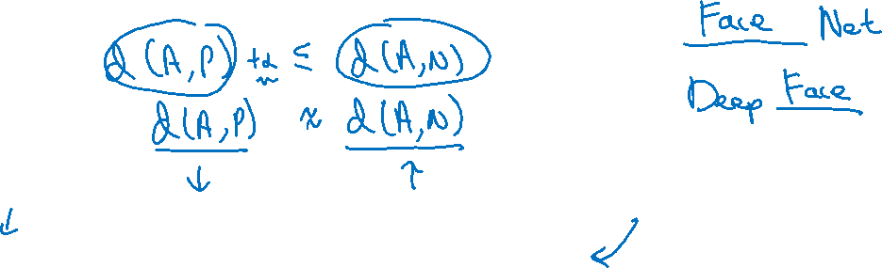
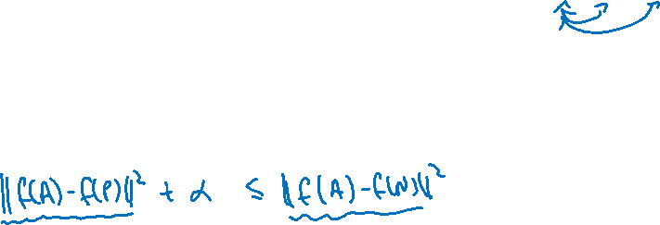
Choosing the triplets A,P,N
During training, if A,P,N are chosen randomly, $d\left(A,P\right)+α≤d(A,N)$ is easily satisfied.
Choose triplets that’re “hard” to train on.
[Schroff et al.,2015, FaceNet: A unified embedding for face recognition and clustering]

Slide 14

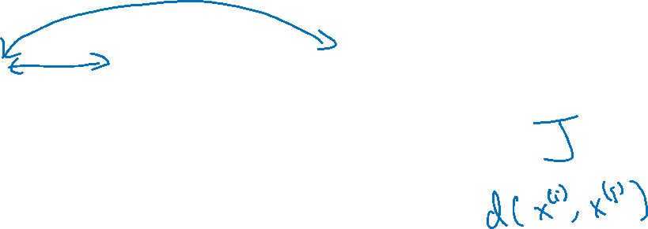
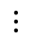
Training set using triplet loss
Anchor
Positive
Negative
$$⋮$$
$$⋮$$
$$⋮$$

Slide 15
Face recognition
Face verification and binary classification
deeplearning.ai

Slide 16
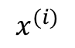
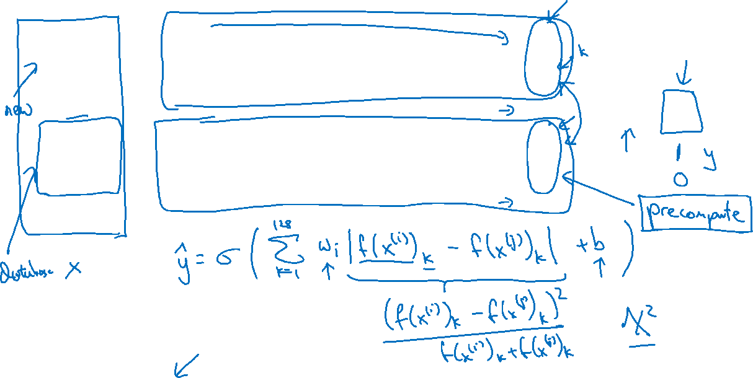
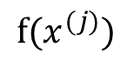
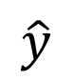
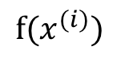
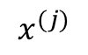
Learning the similarity function
$$⋮$$
$$x^{(i)}$$
$$f(x^{(i)})$$
$$\hat{y}$$
$$⋮$$
$$x^{(j)}$$
$$f(x^{(j)})$$
[Taigman et. al., 2014. DeepFace closing the gap to human level performance]

Slide 17

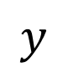
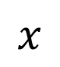




Face verification supervised learning
$$x$$
$$y$$
$$1$$
$$0$$
$$0$$
$$1$$
[Taigman et. al., 2014. DeepFace closing the gap to human level performance]

